Slide 1
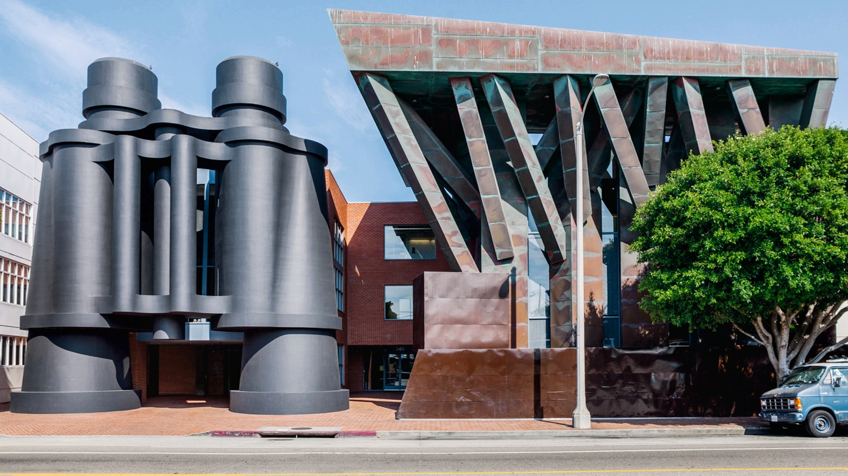
7 Antenarrative Processes
Applied to Architecture & Design
David Michael Boje & Grace Ann Rosile
Keynote May 22, 2022,
Storytelling and Collaborative Future Making
Malmö University, Sweden
SESSION SLIDES at Antenarrative.com
Chiat/Day Building, Los Angeles – architects Frank Gehry and Claes Oldenburg, 1991
Notes:
Claes Oldenburg is a Swedish-born American sculptor, best known for his public art installations typically featuring large replicas of everyday objects. Another theme in his work is soft sculpture versions of everyday objects. Wikipedia
Born: January 28, 1929 (age 93 years), Stockholm, Sweden
Frank Owen Gehry, CC, FAIA is a Canadian-born American architect and designer. A number of his buildings, including his private residence in Santa Monica, California, have become world-renowned attractions. Wikipedia
Born: February 28, 1929 (age 93 years), Toronto, Canada
On view: San Francisco Museum of Modern Art, National Academy of Design, Serpentine Gallery
leading exponent of Deconstructivism, a postmodernist style of architecturedeveloped in Europe and the USA during the period 1980-2000.
The history of Sweden’s architectural monuments, and to the development of Sweden’s institutions of power: palaces, castles, and churches. The break comes with the modern era, with the change in the role of architects in society, towards a concern with questions concerning the entire population, such as housing and the infrastructure of a social democracy.

Slide 2
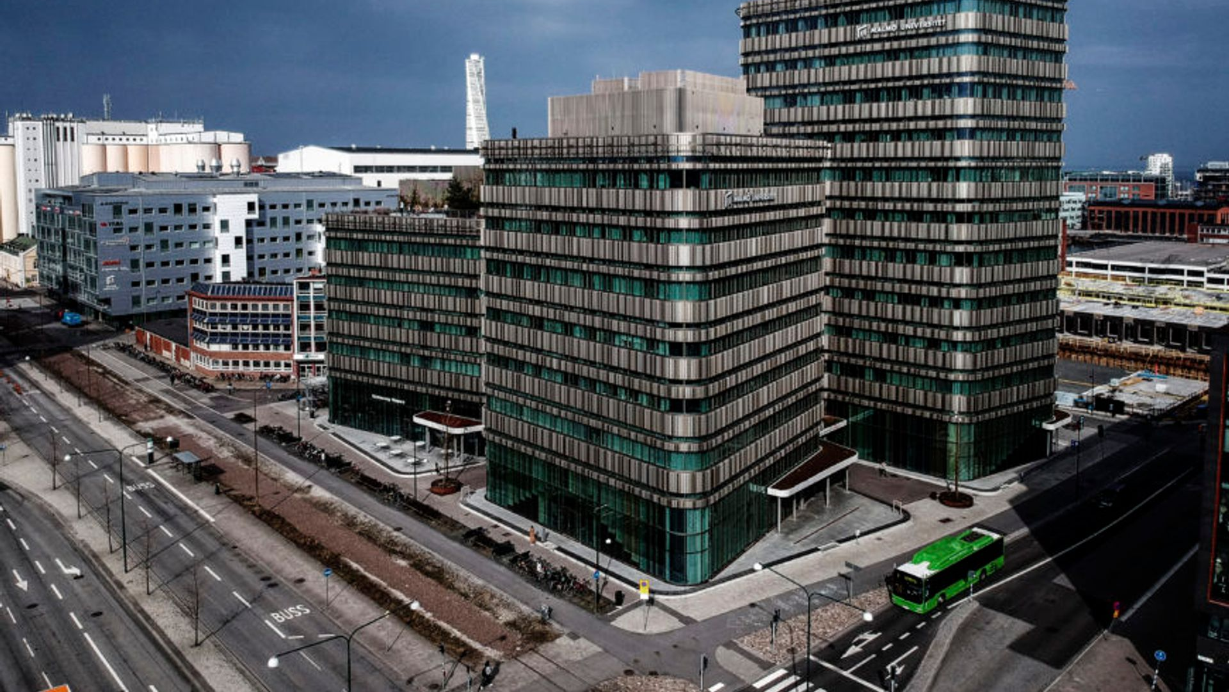
EXAMPLE: Regeneration of an industrial dock to create a building that houses the School of Teacher Education and the main library for Malmö University
What visitors see of contemporary Swedish architecture
SUSTAINABILITY: The facade was originally designed clad in green copper, but this was changed to green-tinted structural glass due to environmental issues
COLLABORATION: Swedish universities are not permitted to own their buildings, Malmö University 'rents' the facilities with a tenure subject to a 20-year lease, whilst the City of Malmö still owns the land
Notes:
Source of text → https://www.ajbuildingslibrary.co.uk/projects/display/id/1270

Slide 3
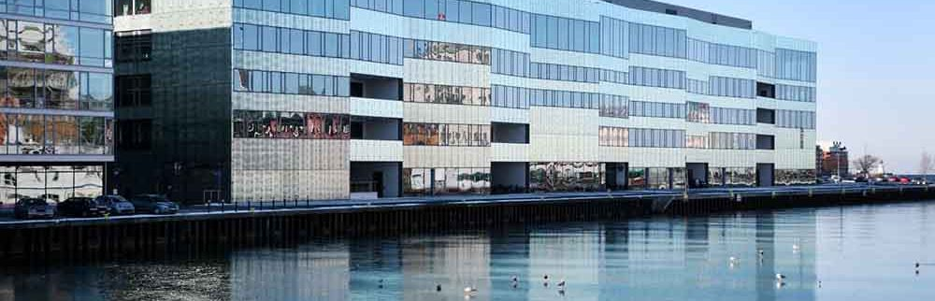
Modern Architectural Style, Malmö University & City Click CITY/University video (Safari works)
Recommend the virtual tour (Chrome browser needed)

Slide 4
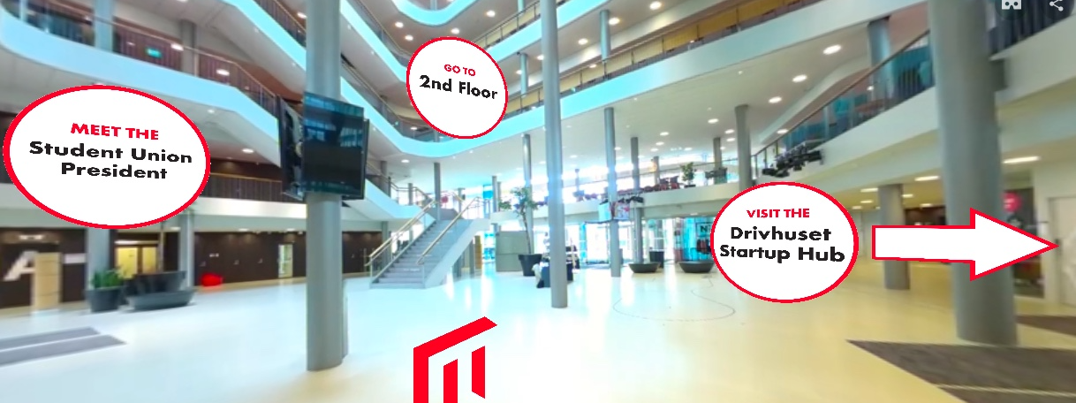
VIRTUAL TOUR
Inside the Modern Facade
What do you see?

Slide 5
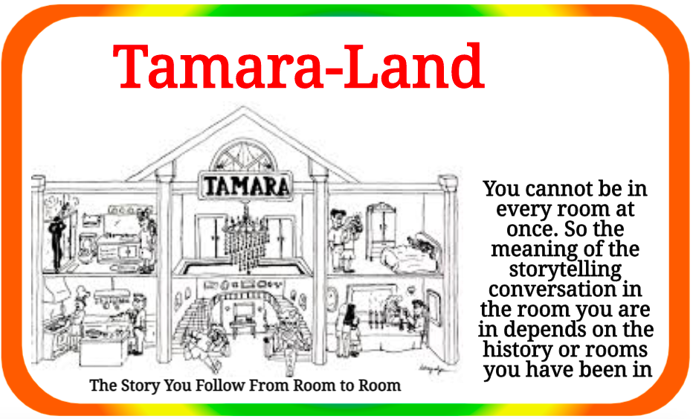
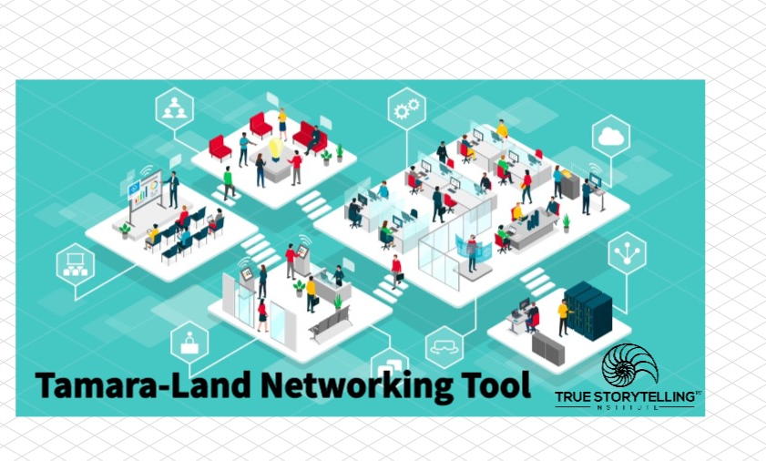
Spaces in Architecture & Storytelling

Slide 6
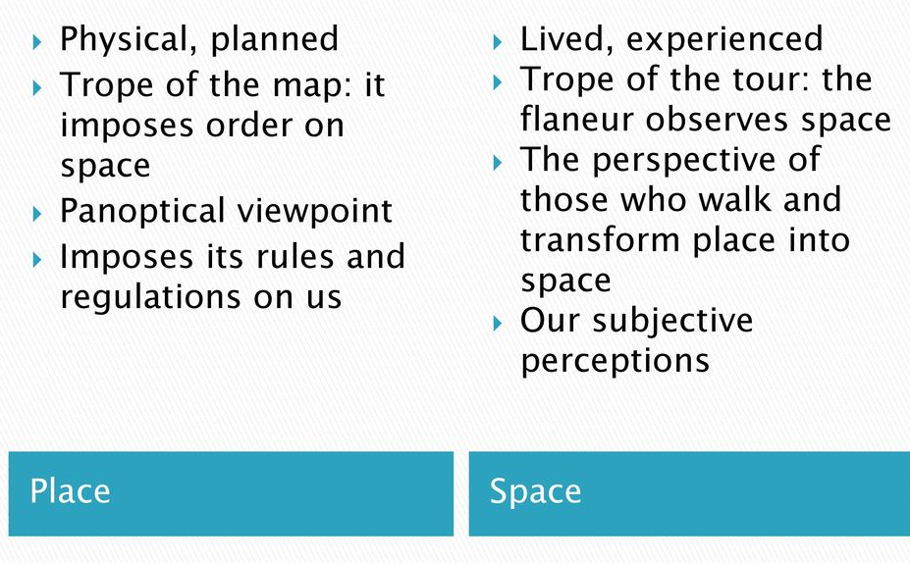
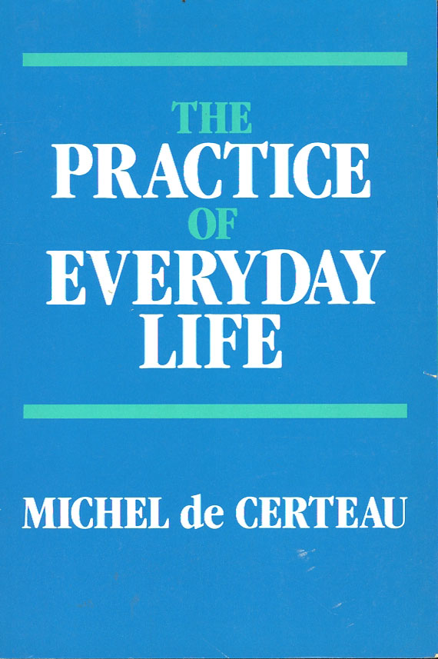
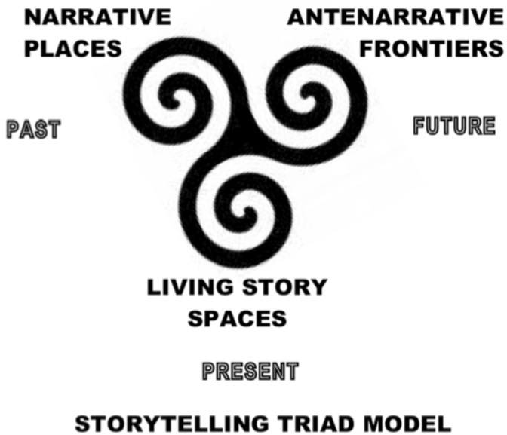
NARRATIVES
LIVING STORIES
Antenarrative Processes
Figure from Boje 2011 Antenarrative Handbook, P. 2
Notes:
It depends on WHO is walking through, and there are 4 WHO’s
Walking through makes it space
Flaneur is de Certeau hats off to the flaneur in Walter Benjamin’s Arcades Project
Aesthetic Walking (La Derive), downloadable app, applying Situationalist aesthetics Guy DeBord
Heidegger’s encounter’s in Being to understand ontology
Bakhtin’s notion of once-occurrent evet-ness of Being in relation to ‘Aesthetic Seeing’ (The Philosophy of the Act book).
Baudrillard’s Simulation and Simulacra (see the book Neo is holding in opening scenes of the movie THE MATRIX, thus the blue pills of simulacrum and the red pill of ontology
See Garfinkel (ethnomethodology) and critical reflexivity in Bob Gephart Jr. in our book together, and how radical reflexivity gets tamed and subdued in representational social constructivism of recent decades, and has been revitalized by Cunliffe, Luhman and Boje, in recent articles, and in 2022 dissertation from Finland by Yaaine T.

Slide 7
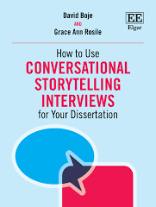
What is LIVING STORY process?
1996 we met Kaylynn TwoTrees and she presented LIVING STORY to us. She is Lakota Native America
We learned from her LIVING STORY has a Time, a Place, and a Mind of its own
LIVING STORY is Indigenous Ways of Knowing IWOK
Living story processes are Future-Making
In indigenous culture, everyone participates in dialogue sessions, for many months, doing what we call LIVING STORY TOGETHER-TELLING
Everyone tells their story, and everyone listens in what Rosile & I call LIVING STORY TOGETHER-LISTENING

Slide 8
What are Western Narrative Architectures?
WWOK is a vessel that holds and restricts the Living Story to a particular form
We call it WWOK (Western Ways of Knowing) to make Narratives & Counter-Narratives for doing Architecture
WWOK Narrative has a linear plot, a Beginning, Middle, & End, and treats this emplotment as the Whole (In my field see Aristotle, Czarniawska, & Weick)
WWOK exceptions in Western Philosophy (Derrida, de Certeau, Ricoeur), and Physics (Einstein) who say such Narratives of a past, present, future is not how time works
We are calling it Living Story , gets edited out or appropriated in (post) colonizing ways that affects architecture

Slide 9
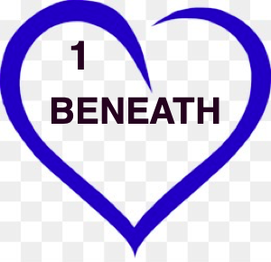
What is Antenarrative Process #1?
Going BENEATH the dualities of subject-object, male-female, silos of facts, opinion vs. opinion to where?

Slide 10

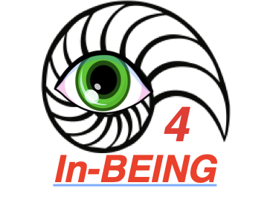
What is Antenarrative Process #1 in relation to Process #4?
ANTEnarrative process #1 means the cognizing theorization of everything in WWOK-narrative-counternarrative (epistemology conflicts)
This process is in a world all its own, cut off from process #4 “that moment of Being which is constituted by the transitiveness and open event-ness of Being” (p. 1).”
SEVERED
Notes:
Heidegger – writes of ‘taken-to-heart’ in What’s Called Thinking book
Bakhtin writes about lovingly
With C.S. Peirce there is a process of the thirdness of Agape continuity

Slide 11
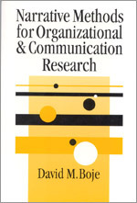

In 2001 I 1st and 2nd Antenarrative Processes in this book:
#2. The BEFORE
#3. The BETS on Future
3
2

Slide 12
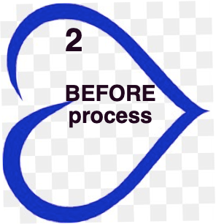
What is Antenarrative Process #2?

Slide 13
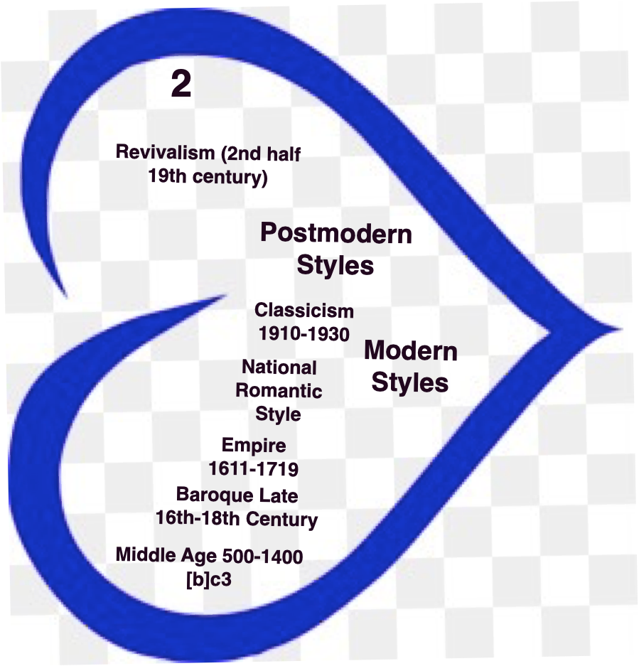
#2 Before Antenarrative Process of Swedish Rehistoricizing Architectural Styles
Middle Ages 500 to 1400–1500 [b]ce
Baroque late 16th-18th century
Empire style (1611-1718)
Classicism (1910-1930) WWOK
Revivalism (2nd half 19th century)
National Romantic style and Jugendstil
Modern
Postmodern
Ecological Design w/Nature

Slide 14
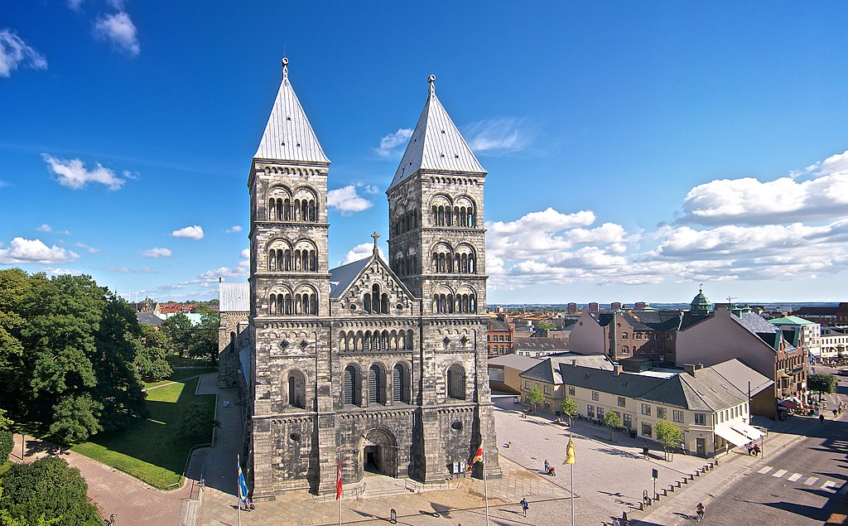
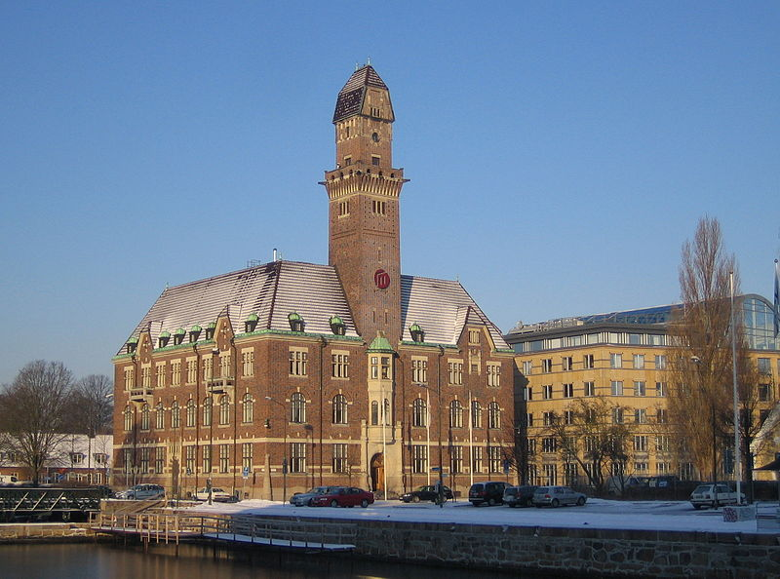
Middle Ages style
(Lund Cathedral &
Malmö högskola main building. Originally the harbour office)
What do
you see?
Notes:
Malmö högskola main building. Originally the harbour office.
What do you see & What are the implications the people in the situation?
What things are we holding onto from the past? How is adapting now?
What things are connected to social norms?
What no longer serves us?
What stories are already there?

Slide 15
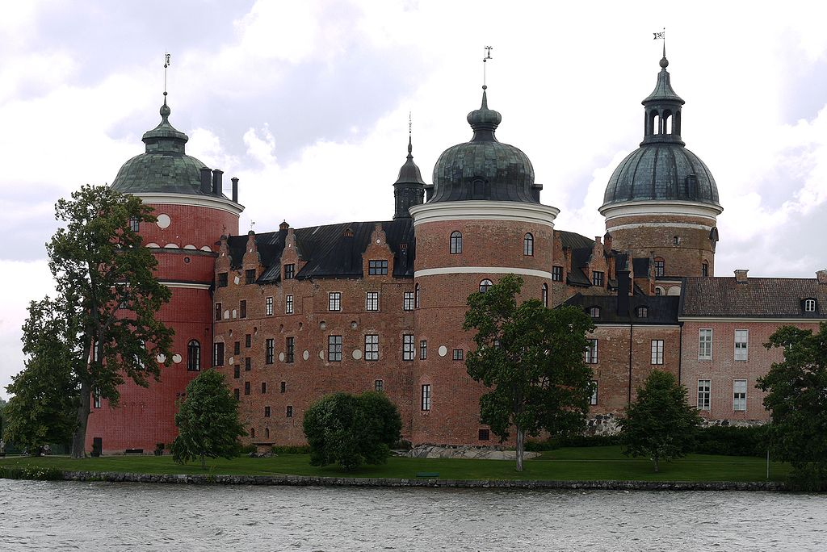
Baroque
Style (Gripsholms slott, Mariefred)
What do
you see?

Slide 16
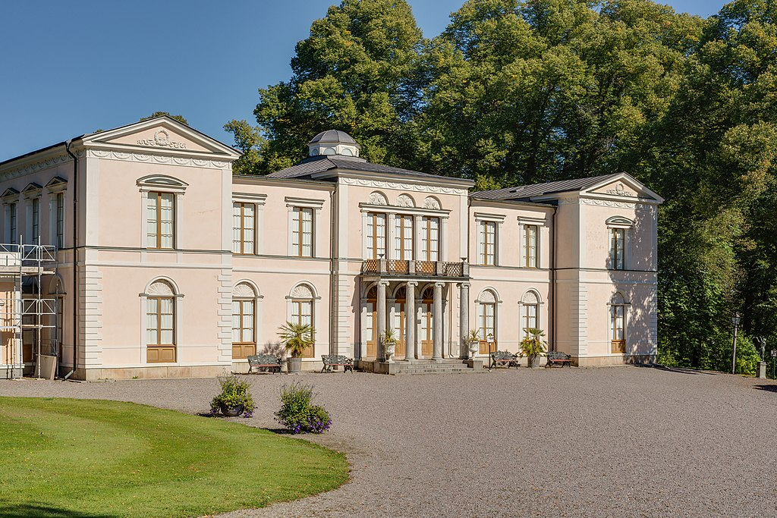
Classicism & Empire style
Resendale Palace
What do
you see?

Slide 17
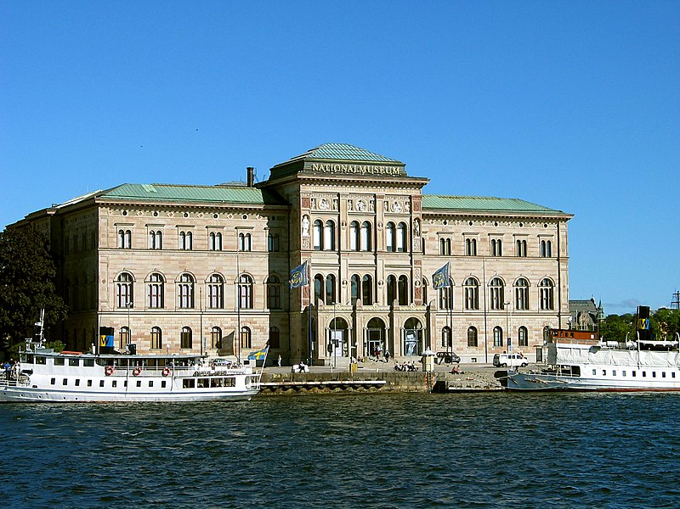
Revivalism
National Museum of Fine Arts
What do
you see?

Slide 18
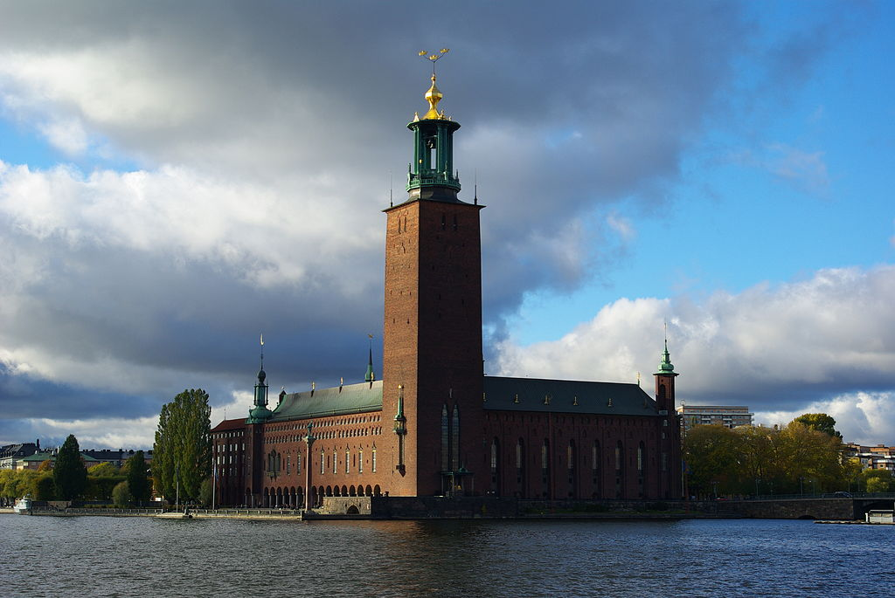
National Romantic style
Stockholm City Hall
What do
you see?

Slide 19
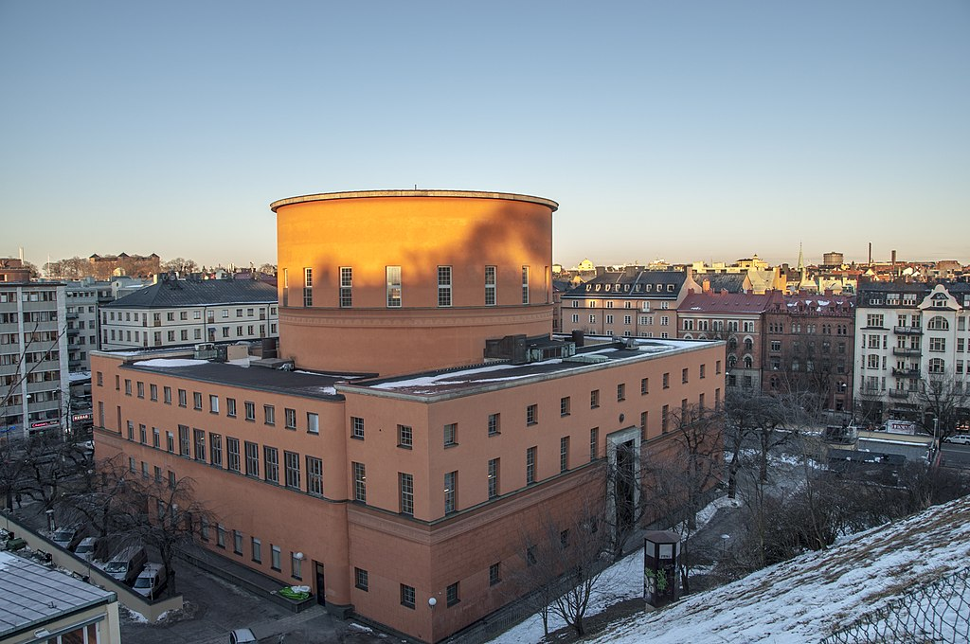
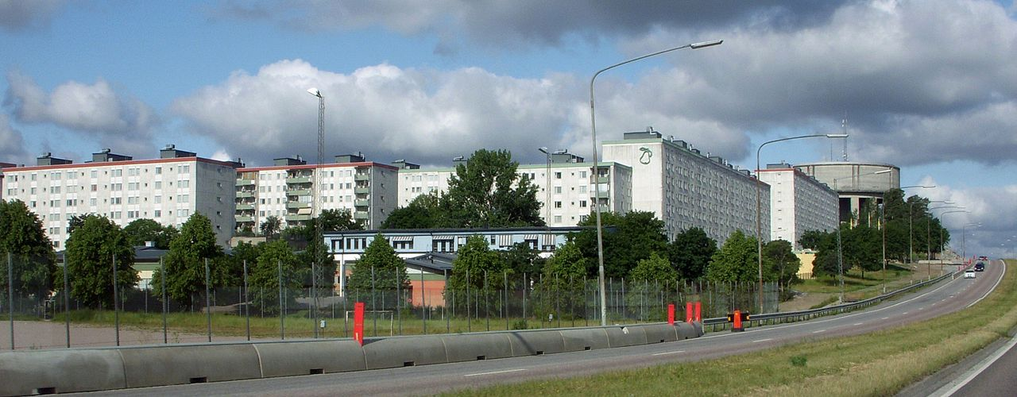
Modern Style
Stockholm Public Library
Million apartsments project inTensta district, Stockholm
What do
you see?

Slide 20
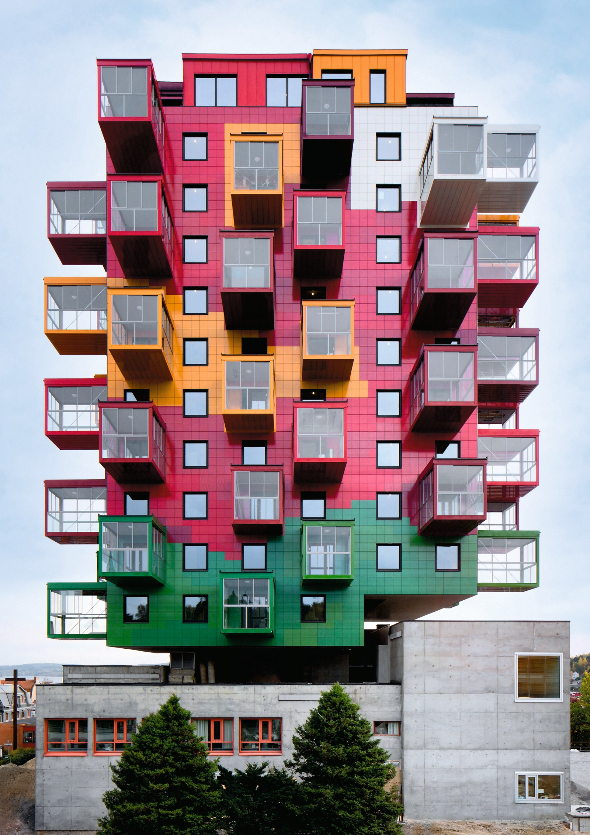
What do
you see?
Postmodern
Style
Ting 1 by Wingårdh Arkitektkontor, 2013
Örnsköldsvik, Sweden
The architect Gert Wingårdh
contrasted the rough concrete block of the old town hall with a playful apartment building with a
precisely defined
colour range

Slide 21
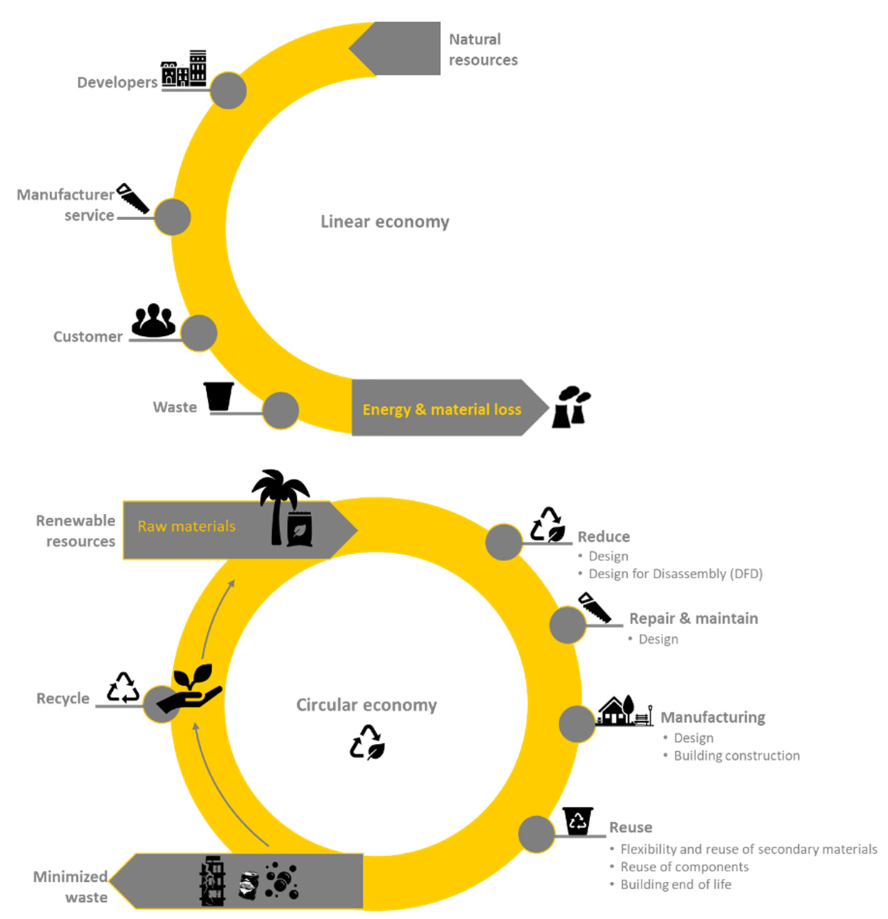
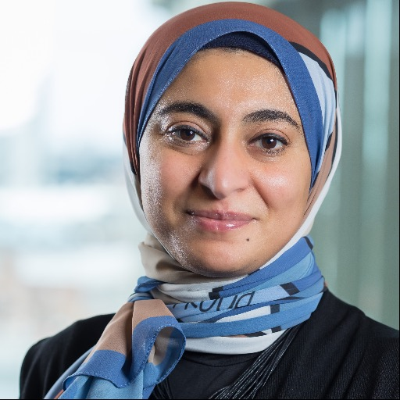
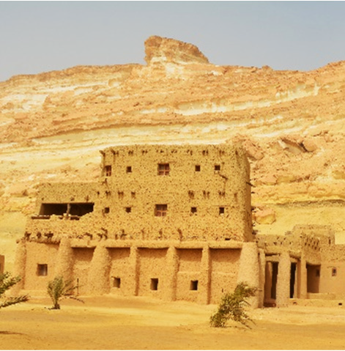
WWOK
IWOK
Malmö University’s Dabaieh, Marwa [with Maguid, D., & El-Mahdy, D.] (2021). Circularity in the New Gravity—Re-Thinking Vernacular Architecture and Circularity. Sustainability, 14(1), 328.
Notes:
https://mau.se/en/persons/marwa.dabaieh/#00Z9VM-0HMHQA427JN8N

Slide 22
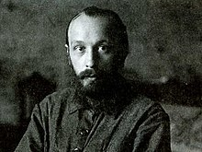
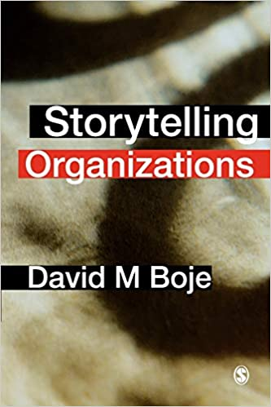
What is Architectonic Dialogism? YouTube for Malmo Doctoral Students
Mikhail Bakhtin (photo in 1920)
Born | 16 November [O.S. 4 November] 1895 Oryol, Russian Empire
Died | 7 March 1975 (aged 79) Moscow, Russian SFSR
Alma mater | Odessa University (no degree) Petrograd Imperial University
Era | 20th-century philosophy
Region | Russian philosophy
School | Dialogic criticism
Institutions | Mordovian Pedagogical Institute
Main interests | literary theory, literary criticism
Notable ideas | Heteroglossia, dialogism, chronotope, carnivalesque, polyphony
2008

Slide 23

What is Antenarrative Process #4?
ONTOLOGICAL BEING & Aesthetic Seeing, Aliveness of Living Story Process, & Disclosing What’s True
Once-Occurrent-
Event-ness of Being

Slide 24
This we symbolize with ANTEnarrative process #4
The “living story” spaces participate in once-occurrent eventness of Being
LIVING STORY has a Time, a Space, and a Mind of its own
Aesthetic activity is also powerless to take possession of once-occurrent eventness of BEING

Slide 25
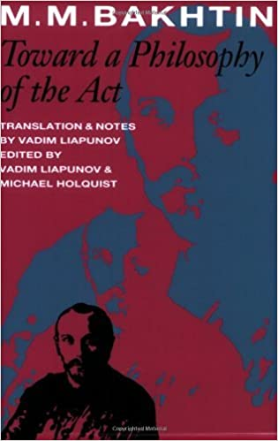
“[…] Aesthetic activity as well is powerless to take possession of that moment of Being which is constituted by the transitiveness and open event-ness of Being” (p. 1).

Slide 26
Bakhtin’s Solution is ‘Participative Thinking’ for Aesthetic seeing, INTERANIMATING
1) Aesthetic discourse, with 2) Cognitive discourse & 3) ANSWERABILITY ETHICS discourse
The Interanimating of 1, 2, & 3 is happening in
(process #4) Once-occurrent-event-ness of Being
“Participative thinking” (p. 8) has footnote #29 by Holquist ‘use of “participative (unindifferent) thinking” relates to p. 19 “my non-alibi-in-Being”
This is TwoTree’s IWOK Living Story in-time, in-space, and in-ongoing eventness that together in Bard (2007) is inseparability of SpaceTimeMattering

Slide 27
When did you feel an Obligation to act in an ethical way, in the
ONCE-OCCURRENT-EVENT-NESS of BEING?
From Past History to Present Here-and-Now
Tell a brief version of your story in
1 minute or less

Slide 28

What is Antenarrative Process #3
Making Bets on the Future is a PROCESS
Many Future-Making Process BETS are in play.
There are ANTES (as in Poker, to commit one to a Future-Making COLLABORATION Path
From Future-Making to Present Here-and-Now

Slide 29
What is Antenarrative Process #5?
Becoming Process from two temporalizing directions to Fulfill in-Being

Slide 31
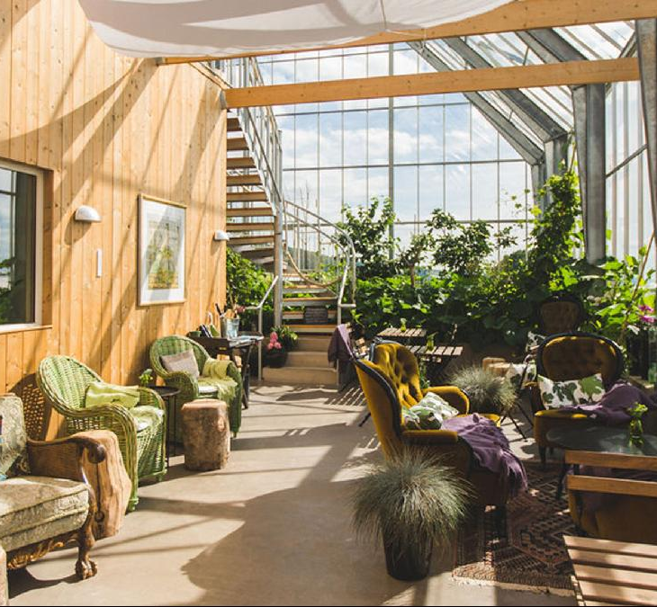
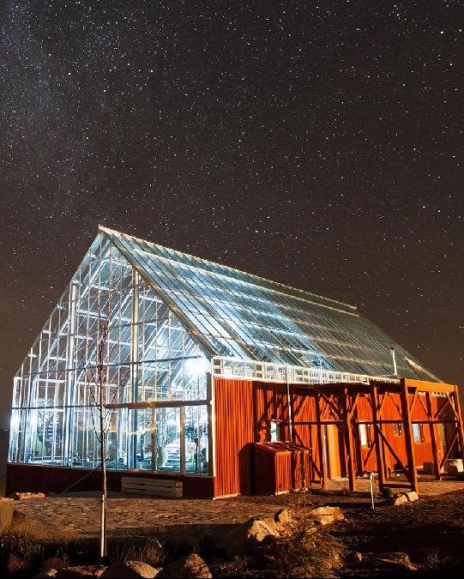
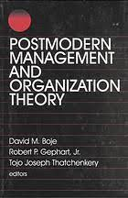
Swedish Eco-friendly House
Notes:
https://propertylistings.ft.com/propertynews/sweden/6594-the-swedish-house-on-the-market-that-offers-a-blueprint-for-sustainable-living.html

Slide 32
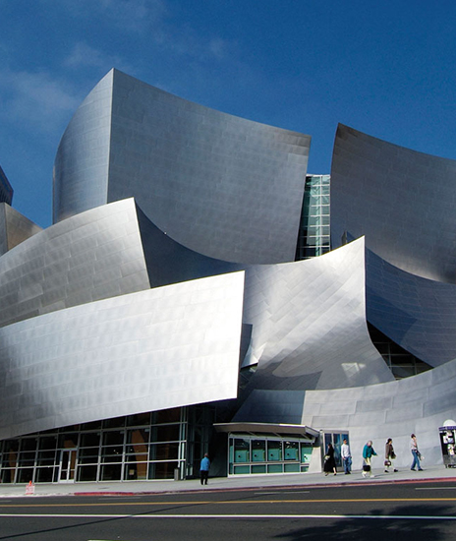
1996 book – Radical Reflexivity becomes focus in how to do sustainability in organizations
1991 Administrative Science Quarterly Article
1995 Tamara-Land Article in Academy of Management Journal is about Disney’s postmodern architecture used for modern purposes
FRANK GEHRY, Architect
Disney Concert Hall

Slide 33
Tell a story…. About Future-Making collaboration
First Person, tell a story of desired
Future Collaboration …
A collaboration with one or more persons that you BET will go especially well…
What will be the secret to success?
Second Person, your story in response to something in Story 1 (or tell a new one)…
Grace Ann & David will demonstrate 2nd part of this Event-ness of BEING
Bets on
Future-Making
Notes:
Demonstrate Conversational Storytelling, To follow the thread, and non-linear story-so-creation

Slide 34
The BETWEEN processes of the Who’s Asking/Doing?
What is Antenarrative Process #6?
The BETWEEN

Slide 35
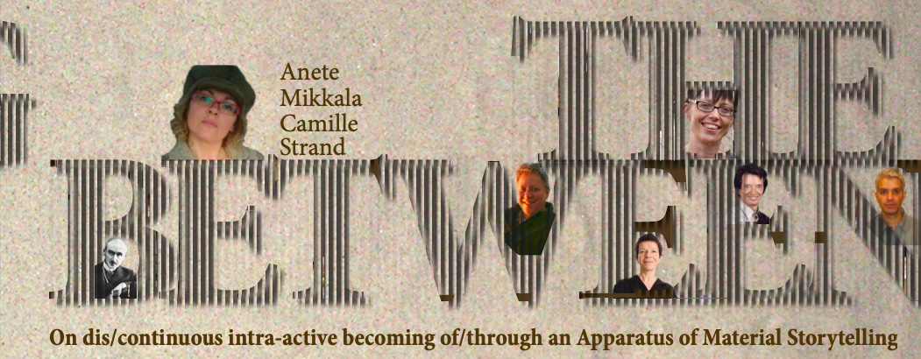
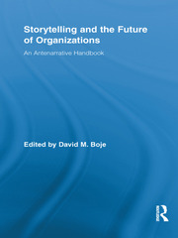
Strand, A. M. C. (2012). Enacting the Between: On dis/continuous intra-active becoming of/through an Apparatus of Material Storytelling. Book 1: Posing (an Apparatus of) Material Storytelling as discontinuous intra-active rework of organizational practices. (Click Here Vol 1) (Click Here Vol 2)
Jorgensen, K., Strand, A., & Boje, D. (2013). Towards a postcolonial-storytelling theory of management and organization. Philosophy of Management, 12(1), 43-66. (click here)
Jørgensen, K. M., & Strand, A. M. C. (2014). Material storytelling–learning as intra-active becoming. Critical narrative inquiry–storytelling, sustainability and power, 53-72. (click here)
Jørgensen, K. M., Strand, A. M. C., Hayden, J., Sparre, M., & Larsen, J. (2021). Down to earth: Gaia storytelling and the learning organization. The Learning Organization. (click here)
Boje, 2011: p. 2
2011
Antenarrative Handbook
Notes:
Strand, A. M. C. (2012). Enacting the Between: On dis/continuous intra-active becoming of/through an Apparatus of Material Storytelling. Book 1: Posing (an Apparatus of) Material Storytelling as discontinuous intra-active rework of organizational practices. (Click Here Vol 1) (Click Here Vol 2)
Jorgensen, K., Strand, A., & Boje, D. (2013). Towards a postcolonial-storytelling theory of management and organization. Philosophy of Management, 12(1), 43-66. (click here)
Jørgensen, K. M., & Strand, A. M. C. (2014). Material storytelling–learning as intra-active becoming. Critical narrative inquiry–storytelling, sustainability and power, 53-72. (click here)
Jørgensen, K. M., Strand, A. M. C., Hayden, J., Sparre, M., & Larsen, J. (2021). Down to earth: Gaia storytelling and the learning organization. The Learning Organization. (click here)

Slide 36
The 4 Who’s of the Antenarrative BETWEEN process

Slide 37
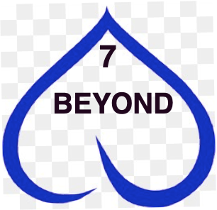
What is Antenarrative Process #7

Slide 38
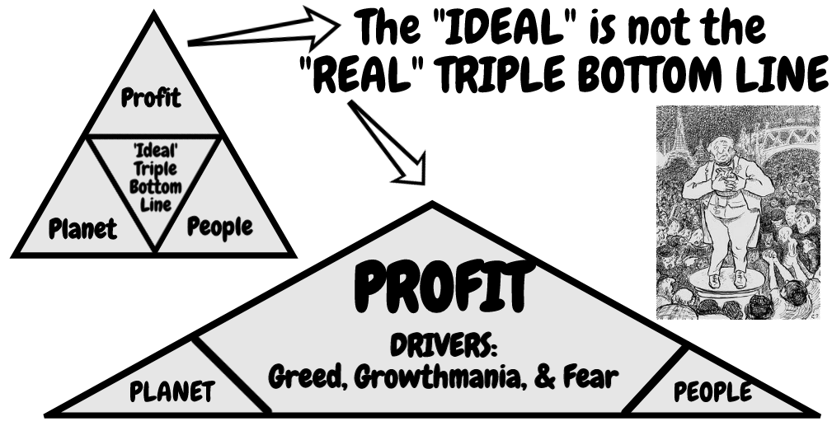
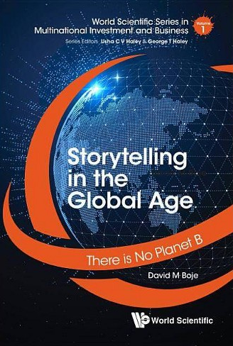
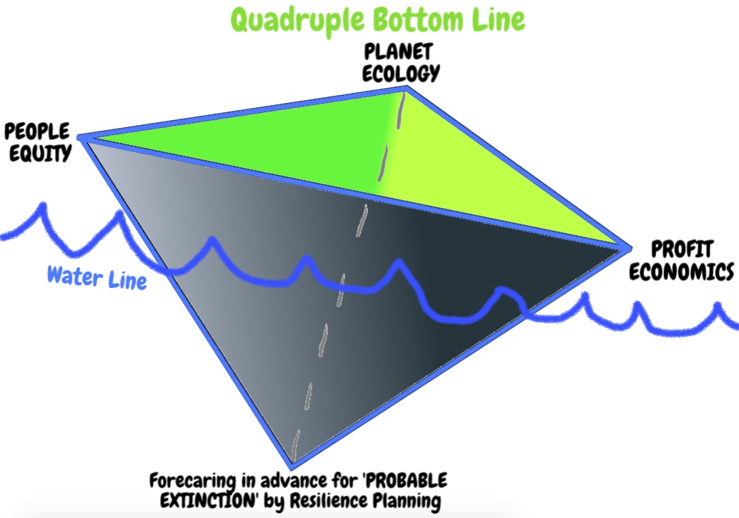
Critiques of Triple Bottom Line & My 4BL proposal
Sparre, Mogens; Boje, D. M. (2020). "Utilizing participative action research with storytelling interventions to create sustainability in Danish farming." Leadership & Organization Development Journal 38.4: 41-54. Click here for pre-press pdf

Slide 39
Boje in 2020 created a critique of Circular Economy on Wikipedia when there was none (click here)
Boje added, Valenzuela, Francisco; Böhm, Steffen (2017). "Against wasted politics: A critique of the circular economy". Ephemera. 17 (1): 23–60. and wrote a critique, now its been rewritten many times, and countered by counter-narratives.
And want to add these:
Boje, David M.; Jorgensen, Kenneth Mølbjerg. (2020). A ‘storytelling science’ approach making the eco-business modeling turn. Journal of Business Modeling, Vol. 8, No. 4, pp. 8-25. Click here for pre-press pdf. Please Click here for final print version PDF
Boje, David M.; Rana, Mohammad B. (2020). Defining a Sustainably-Driven Business Modeling Strategy with a ‘Storytelling Science’ Approach. Chapter to appear in Markovic, S., Sancha, C. and Lindgreen, A. (Eds.), Handbook of Sustainability-driven Business Strategies in Practice, Northampton, MA: Edward Elgar. Click here for pre-press pdf.

Slide 40
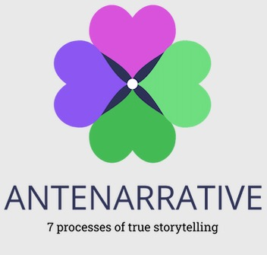
Bakhtin meets Enthinkment Circle - YouTube (filmed May 15, posted May 17 2022)
Thank you for the conversations
Grace Ann Rosile Horsesenseatwork.com
SESSION SLIDES at Antenarrative.com
True Storytelling Institute TrueStorytelling.org
Boje’s Home site DavidBoje.com
For more on Enthinkment Circle visit Enthinkment.com

