Slide 1

Storytelling and Organizational Consulting
David Michael Boje
DavidBoje@pm.me

Slide 2

What is your Consulting Future after AI?
David Michael Boje
DavidBoje@pm.me

Slide 3
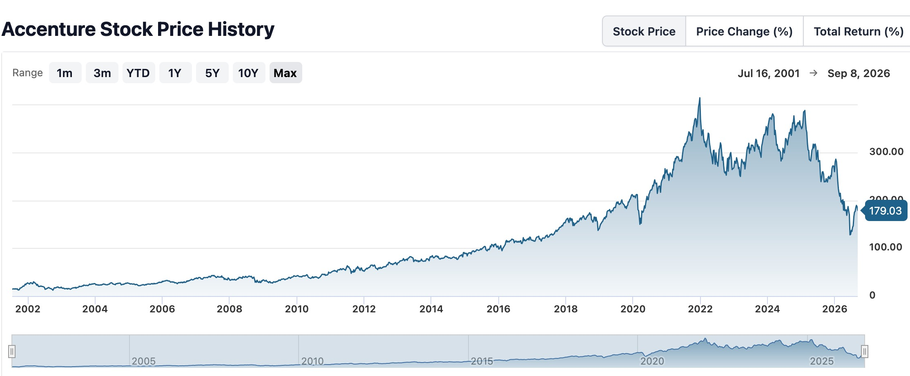
IN CHAT:
What’s your storying of the Accenture Future?
https://davidboje.com/ws/
https://davidboje.com/aibets/
https://Storying.site

Slide 4
Chapter 1: The Main Consulting Company Protagonists of the Consent Machine - Table 1
Organization | Impact Data Point | Note on Role
Accenture | 77,000 AI professionals | Largest deployment of AI implementation labor.
McKinsey & Co | 10% internal staff cut | Selling AI transformation while cutting their own staff.
BCG | 25% of 2025 revenue | A quarter of all revenue now derived from AI consulting.
Deloitte | "Unhearing" staffing studies | Focus on efficiency metrics over human welfare.
IBM Consulting | Enterprise Layer Architect | Designing the specific tasks AI agents will replace.
PwC | Institutional Cover | Providing the "narrative shield" for radical change.
EY | Billion-dollar influence | Aggressive scaling of AI auditing and transformation.
KPMG | Trust/Usage studies | Shaping the public perception of AI reliability.
Infosys Consulting | Retail/Logistics focus | Redesigning global physical supply chains.
Cognizant Consulting | Gov/Healthcare focus | Moving AI into sensitive public and medical sectors.

Slide 5
What is your AI Data Center COMPLICITY?
I traced every AI data center I touch: 16 sites.
storying.site + DavidBoje.com → Houston DataBank 5170 Westway Park + Ashburn Equinix DC11 (same HostGator account, IP 192.185.16.216)
tamaraland.us → Porkbun pixie → AWS Oregon Hillsboro
quantumstorytelling.org → Namecheap → phoenixNAP Phoenix 3402 E University
Gmail/Maps/YouTube/Search → Google Mesa $600M 185 acres + Council Bluffs IA + Mayes OK
Netflix → No Netflix DCs — AWS control + Open Connect OCA inside Lumen Albuquerque 3830 Singer Blvd (70mi N of Caballo) — 95% traffic, 19k OCAs, 15% global internet
Amazon/Prime → AWS Phoenix Local Zone + Dallas CloudFront + Project Jupiter Santa Teresa $165B 1,400 acres 2.45GW Bloom fuel cells — 40 miles south of Las Cruces, IN DOÑA ANA COUNTY
NMSU Microsoft 365 + Copilot → West US 3 El Mirage 12901 W Olive Ave + Goodyear Airpark + South Central US San Antonio SAT82 18844 FM 1957 $482M
Fisk Microsoft 365 + Visiting Scholar → East US Virginia Bristow VA + Central US Iowa + Fisk Quantum Leap 70k sq ft 30MW $400M Innovation Center North Nashville (14k petition, Rep Justin Jones) — second self-reflexive loop
Facebook → Meta Los Lunas 4250 Messenger Loop $2.2B 40MW 6 buildings — 60 miles north of Caballo! + Gallatin TN $1.5B 500MW 60 miles from Fisk
Proton Mail → Lausanne + Attinghausen Switzerland K7 bunker under 1000m granite — genuine non-US exit
Zen Browser → No DC, local Firefox-based tracker block — genuine exit
Click Here to check your AI complicity

Slide 6
Main Point Today:
BME-Narrative vs Storying
Official consulting plot is a BME Narrative
Beginning: capability gap.
Middle: train, stand up agents, certify ethics.
End: productivity, readiness, headcount “grows again.”
Aristotle’s whole is intact. The invoice can close, BUT Storying does not close.
STORYING stays in the middle
Antenarrative = Hundreds of fragments are already betting a future the earnings call has not plotted.
Qualimetrics refuses the BME because a ledger without storying treats living work as if it were already a report.
Storying without a ledger leaves the IMPORTANT CHANGE off the books.

Slide 7
Sherry Andrews (composite character)
Will You be the next Sherry, after graduating Penn. State?
Sherry is not a verified employee file.
We name her so the voiceless can enter the room.
We do not hunt a LinkedIn identity and we do not claim she was fired so Accenture could buy Anthropic AI
Sherry joined Accenture January 2025; head an account within a month;
She worked till midnight three nights one week;
Kept her hours off the timesheet;
In the chat
Write one word — which indicator is loudest about her future?

Slide 8
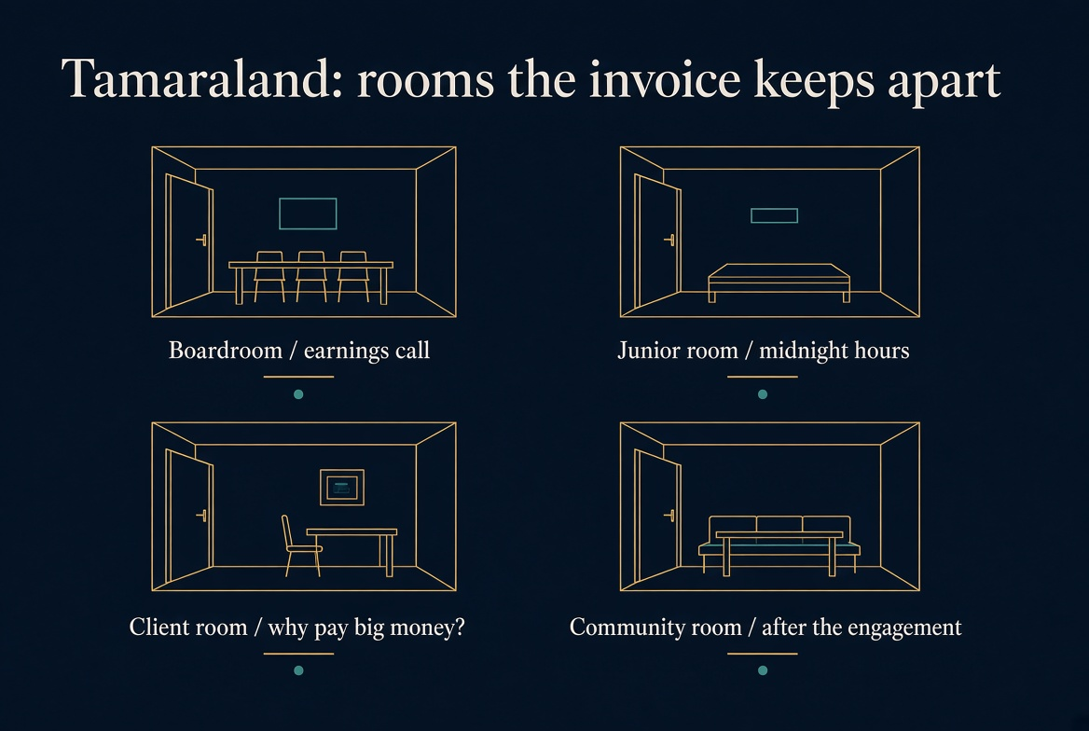
Tamaraland rooms
Four simultaneous rooms of one machine:
Boardroom: “exit on a compressed timeline” those who cannot be reskilled.
Junior room: midnight work, +1 extras, hours that will not go on the timesheet.
Client room: “why pay big money?” once a toolchain exists (price compression).
Community room: data-center and welfare-system consequences after the engagement is invoiced.

Slide 9
Julie Sweet, real Chair & CEO.
Sherry Andrews, composite junior / exited cohort.
The January 2025 story is real as reported and unnamed. Sherry is VOICE OF THE VOICELESS
The $14.4B is the hypothetical case.
Utilization has been ~92–93%. The billable hour did not die.
Promotion for the layer above you already tracks regular use of internal AI tools (weekly logins in some talent reviews).
Compressed-timeline exit is still the published rule for people judged not reskillable. Headcount can grow and your class can be rotated.
It is September 2026. You accepted Analyst / Analyst–Data & AI at Accenture.
Julie Sweet is still the named CEO of the official room.
Sherry Andrews is the composite who joined in January 2025 is now gone.
You are the next cohort.
Chat is open. What will you do?

Slide 10
The BME Narrative
Beginning · Middle · End
B
M
E
→
→
Beginning
Middle
End
Problem or tension introduced.
Context is established; the world is incomplete or disrupted.
Complication unfolds.
Events, agents, and forces collide; stakes are raised.
Resolution achieved.
A solution is found; order is restored or transformed.
Czarniawska (2004): narrative as a sequence with a problem and its resolution · Weick (1995): retrospective sensemaking through storied form · Boje (2001–2026): the BME as dominant narrative convention

Slide 11
Treatment in the AI era, in one sentence:
You are hired as AI-fluent inventory, not as an apprentice being formed for partner judgment. Sweet said the quiet part: the college hire’s edge is fluency relative to people already inside. That is a compliment and a warning.
DEBRIEF after Group Report out
Boje Answer: What working conditions would likely feel like
Official BME room (Sweet) | Living-story room (Sherry → you)
“Reinventor.” Train, certify, use the toolchain, grow again. | Two clocks on one body: chargeability and tool adoption.
Mentorship + young-graduate “journey” language. | Seniors reviewing AI drafts at midnight; you are the +1 on an already-staffed account.
AI fluency is your hiring advantage over the 2024–25 class. | That advantage expires the day a cheaper, more fluent 2028 class arrives.
47 million training hours / green dashboard. | Hours that will not go on the timesheet. Dual-process: judge the model and hit the week.
Federal / geopolitics / stock multiple still squeezing cost. | PIP, utilization, and “not a viable path” remain the exit grammar.

Slide 12
How long would you last at Accenture ?
“Which clock are you willing to live on?”
Clock | What it measures | Honest 2027 range
Official tenure story | “Vibrant careers”; 97k promotions in FY2025; more entry-level hires | Some will make Analyst → Consultant in 2–3 years if utilization + tool use + a live account line up
Sherry’s clock | Joined Jan 2025; planned to leave at one year; same week as Sweet’s exit sentence | 12–18 months if the account is +1 extras, OT off the timesheet, and no safe path up the power chain
Firm clock | 14% voluntary attrition; compressed window of ~11–12k in one quarter; pyramid still needs juniors | Many will be managed out or self-exit before the competency grid is ever drawn
Notes:
“I’ll be fine; I’m AI fluent.”
That is exactly why they hire you in 2026–27. Fluency is the entry ticket. It is also what makes you replaceable by next year’s fluent class. SEAM: fluency without a competency grid is a certificate, not judgment.
“They wouldn’t treat us like Sherry; that’s India / first-year exploitation.”
Same machine, different rooms. Utilization, +1 staffing, and promotion-by-login are global rules with local intensity. Do not let geography close the case.
“I’d last five years because I want consulting.”
Possible. Also how the pyramid works: a few stay; the rest fund leverage. Ask what they will refuse to leave off the timesheet. That is the only agency SEAM grants a junior.

Slide 13
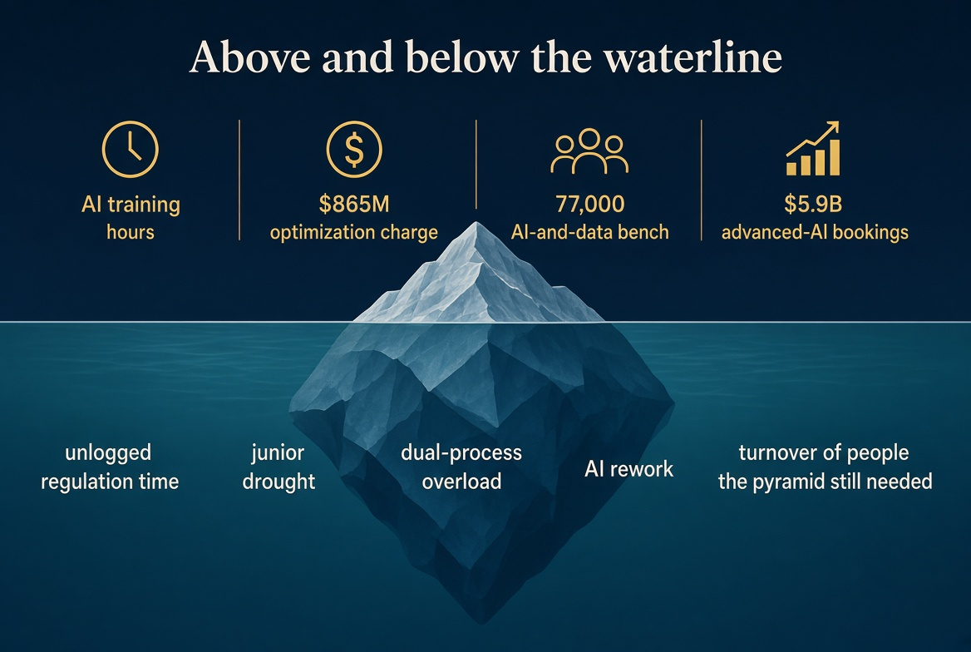
Above the waterline (measured, narratable, billable).
Below the waterline (lived, unlogged, transferred).
Examples welcome: 47 million training hours / weekend calls / $865M charge / partner name on AI-speed text.

Slide 14
The Seven Antenarrative B's: Definitions and Examples of STORYING
Boje (1991 ASQ, 2001, 2014) | Boje & Rosile (2016)
ANTENARRATIVE B
DEFINITION
EXAMPLE (Boje / Rosile)
Befores
Multiple, contested starting points -- not one Beginning, but many, held by different actors.
Workers' story of the office supply crisis began before management even noticed. (Boje 1991 ASQ)
Being
Ready-to-hand -- absorbed in practice, living the story without stepping outside it.
Shop floor workers living the daily story; no arc, no resolution visible from inside. (Boje 1991 ASQ)
Becoming
Present-at-hand -- the moment a situation surfaces as a story, noticed and named.
Union resistance made the supply crisis suddenly visible -- management now saw it AS a story. (Boje 1991)
Bets
Different actors hold different expected endings -- competing bets on the future.
CEO bets on acquisition; workers bet on layoffs; investors bet on growth. (Boje 1991 ASQ)
Beneath
Tacit, hidden, suppressed -- what official stories bury or refuse to name.
Labor conditions and supplier exploitation concealed beneath the efficiency narrative. (Boje 2001)
Beyond
Ethical, transcendental obligations that exceed the organization's own purposes.
Environmental obligations and community duties not written into the company story. (Boje 2014)
Between
Dialogic polyphony -- multiple simultaneous perspectives in active, ongoing dialogue.
Corporate-Who, Workers-Who, Social-Who, Ecological-Who each narrating differently. (Boje & Rosile 2016)

Slide 15

What Will You Do?

